Slide 1
Composite Design Pattern

Slide 2
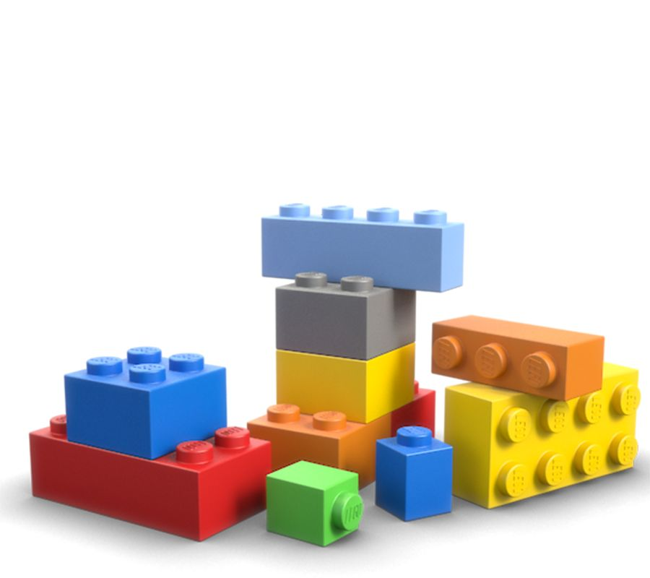
Modeling Part-Whole relationships
We often define something to be ”composed” of other things
A Car can be ”composed” of wheels, seats, engine, etc..
In some situations, it makes sense to be able to treat the ”whole” in the same way as the ”parts”

Slide 3
Modeling Part-Whole relationships
A Lego structure consists of Lego blocks

Slide 4
public interface ILegoBlock
{
double Weight { get; }
string Description { get; }
}

Slide 5
public interface ILegoStructure
{
double TotalWeight { get; }
int NoOfBlocks { get; }
}

Slide 6
public class LegoBlock : ILegoBlock
{
public double Weight { get; }
public string Description { get; }
public LegoBlock(double weight, string description)
{
Weight = weight;
Description = description;
}
}

Slide 7
public class LegoStructure : ILegoStructure
{
private List<ILegoBlock> _blocks;
public LegoStructure(List<ILegoBlock> blocks)
{
_blocks = blocks;
}
public double TotalWeight
{
get { return _blocks.Select(b => b.Weight).Sum(); }
}
public int noOfBlocks
{
get { return _blocks.Count; }
}
}

Slide 8
Modeling Part-Whole relationships
A Lego structure consists of
Lego blocks, and
Lego structures

Slide 9
public interface ILegoStructure
{
double TotalWeight { get; }
int NoOfBlocks { get; }
string Description { get; } // Added
}

Slide 10
public class LegoBlock : ILegoStructure
{
public string Description { get; }
public double TotalWeight { get; }
public LegoBlock(double weight, string description)
{
TotalWeight = weight;
Description = description;
}
public int noOfBlocks { get { return 1; } }
}

Slide 11
public class LegoStructure : ILegoStructure
{
private List<ILegoStructure> _parts;
public LegoStructure(List<ILegoStructure> parts)
{
_parts = parts;
}
public double TotalWeight
{
get { return _parts.Select(b => b.TotalWeight).Sum(); }
}
public int noOfBlocks
{
get { return _parts.Select(b => b.noOfBlocks).Sum(); }
}
public string Description { get { return "Composite"; } }
}

Slide 12
public void PlayWithLego()
{
ILegoStructure blockA = new LegoBlock(3, "6-dot");
ILegoStructure blockB = new LegoBlock(3, "6-dot");
ILegoStructure blockC = new LegoBlock(4, "8-dot");
List<ILegoStructure> listA = new List<ILegoStructure>{ blockA, blockB, blockC };
ILegoStructure structA = new LegoStructure(listA);
ILegoStructure blockD = new LegoBlock(8, "16-dot");
ILegoStructure blockE = new LegoBlock(4, "8-dot");
List<ILegoStructure> listB = new List<ILegoStructure>{ blockD, blockE, structA };
ILegoStructure structB = new LegoStructure(listB);
Console.WriteLine($"Structure A {structA.TotalWeight} gr., {structA.noOfBlocks} blocks" );
Console.WriteLine($"Structure B {structB.TotalWeight} gr., {structB.noOfBlocks} blocks");
Console.ReadKey();
}

Slide 13
ICompositable
Leaf
Composite

Slide 14
Client
ICompositable
Leaf
Composite

Slide 15
ICompositable
Compositable
Leaf
Composite

Slide 16
Composite pattern
Composite class will often contain methods and properties for building/ maintaining the ”composed” structure
AddChild
RemoveChild
Children
…etc.

